Slide 1
Computer Network Security
Ch. 6

Slide 2
Outline
Computer Network Threat Model
Protocol Insecurities
DDoS
Wireless
Defenses: TLS, Firewalls, IDS, IPS

Slide 3
Computer network security threat model
Notes:
Asymmetric advantage
Attack from far away!
CVSS highest – why?
Vulnerable to interception – why?

Slide 4
Asymmetric advantage
Notes:
Need to keep services up!

Slide 5
CVSS example – which is the worst threat??
https://www.first.org/cvss/examples

Slide 6
Network Security
Notes:
Is network security a unicorn? Maybe

Slide 7
Network attacks
Eavesdropping
Data corruption
Sequencing
Substitution
Insertion
Replay
Interruption
Notes:
What makes a network vulnerable to interception?
Anonymity, open medium, asymmetric advantage, sharing,
system complexity – most people do not know what is running on their computer let alone how a network works
Unknown perimeter
Unknown paths
Sequencing – TCP for reordering, programs may not detect sequencing problems
Substitution – complex cables, errors, adversary can do this by splicing communication – MiTM – Encrypt! Chaining
Replay – legitimate data is intercepted and reused, replay authentication credentials, cookie hijacking – attacker intercepts cookie and replays it, TCP Sec
Interruption – loss of service
Routing – misused it can cause DoS, overwhelm a router
Excessive Demand – DoS, large files, too many connections
Github DoS

Slide 8
Network transmission media
Cable
Packet Sniffing
Radiation
Cable Splicing
Optical Fiber
Satellite Communication

Slide 9
Eavesdropping!
Elevated privileges
Libpcap/Winpcap
Pcap/Pcapng
Notes:
Since raw network adapter access requires elevated privileges these functions are isolated into the dumpcap program.
Closely works with the computer’s NIC
These libraries provide a general purpose interface to capture packets
Natural file formats - used also by tcpdump
Wireshark tries to detect the packet type and gets as much information from the packet as possible. In this run though, only the information shown in the packet list pane is needed.
If you run wireshark on your computer and your computer is connected to a (swtich), wireshark will only see packets/frames from your pc to the switch. Wireshark cannot see other traffic on the network because a switch will not allow that. You can configure the switch to forward traffic to a specific port, but it has to a manageable switch like a Cisco 2960.

Slide 10
Side channel
Radiation
Cable Splicing
Notes:
Inductance
Electromagnetic radiation
Antenna close to cable – pick up signal
Inexpensive, easy to obtain
Wiring closet
Sniffer – rubber ducky
Multiplexing of signals – intercept and demultiplex

Slide 11
Optical Fiber
Notes:
For the most part secure
Can still be tampered
Not inductive, no electric signal
Splices and taps can happen

Slide 12
Microwave
https://www.daenotes.com/sites/default/files/article-images/transmission-method-in-current-communication-networks_1.PNG
Notes:
Line of sight tech
Broadcast, insecure
Requires clear sight
More used now that we use wireless
Not shielded or isolated to prevent interception
Interceptor is unlikely to separate transmission
Satellite is similar
Broadcast and can be intercepted but tough to demux

Slide 13
Outline
Computer Network Threat Model
Protocol Insecurities
DDoS
Wireless
Defenses: TLS, Firewalls, IDS, IPS

Slide 14
Steven Bellovin’s Security Problems in the TCP/IP Protocol Suite (1998)
Bellovin’s observations about security problems in IP
Not really a study of how IP is misused (e.g., IP addresses for authentication), but rather what is inherently bad about the way in which IP is set up
A really, really nice overview of the basic ways in which security and the IP design is at odds
Notes:
IP spoofing is a great example: anyone can claim they have an IP and none checks, TCP sequence numbers is another example that we examine in detail in the next slides.
Surprisingly (and sadly) even though this is a 20 year old paper, the protocol weaknesses are still present, some are mitigated. 20 years old is equivalent to ancience in CS, however there are seminal papers that can point us to vulnerabilities.
Meltdown and spectre is a great example: they are based on the observations of a paper 26 years old. Caching has really improved performance but is a part of the cause of these two attacks. The General Law of Cross-Task Information Leakage: “In any setting where short-term performance optimizations have global effect, a sufficiently clever task can infer the recent history of other tasks by observing its own performance.”
The question rises about network protocols: if you have a fundamentaly unsecure protocol, is there any way to add security later?

Slide 15
TCP Sequence Numbers
TCP’s “three-way handshake”:
each party selects Initial Sequence Number (ISN)
shows both parties are capable of receiving data
offers some protection against forgery -- WHY?
Notes:
32-bit number, increases according to size of pack, ex. If it is 100 bytes, seq + 100.
Why do sequence numbers exist in the first place? Out of order packets.
Why out of order? Because routing – if a router interface is backed up, next packet may be routed to another router, a later sent packet may arrive sooner
Starting from 32-bit numbers: is it enough? 2^32 combinations with todays computation capability doesn’t cut it. But tcp handles gracefully anything above 4 million – wrap around. So designers thought: oh well, good enough
Ack bit set back and forth after handshake (connection established): acks that bytes have been received

Slide 16
TCP SNs
Notes:
Connections identified by: IP src, dst, port src, dst. If you took apart the connection and then brought it back up, augmenting seq nums guarantee that old connection packets would not be received by new
Numbers do not start from zero but from “first number” whatever that is and they move uniformly up…

Slide 17
TCP SNs
Notes:
Hackers talk to server, i.e., current router, find a syn/ack seq number, they know it advances uniformly. So on the next connection they can guess the initial seq number. MiTM at its best!

Slide 18
How do we fix this?
More rapidly change ISNs
Randomize ISNs
However more attacks popping:
Side channel android attack: https://www.grc.com/sn/sn-355.htm
…
Notes:
Even randomization has its issues: seq numbers still need to keep going up! Therefore, 5 highest bits have to stay the same, only 256 combinations – not much
What characterizes a connection: Src port is tough to figure out? Not really! Increasing port by OS
Malware on android that can run netstat and give you these increasing numbers, guess the next netstat –s shows counters!
Proc file in linux, malware to read proc file unprivileged. This sandboxing in android guarantees to put nice malware without noticing, sidechannel

Slide 19
Source Routing
Standard IP Packet Format (RFC791)
Source Routing allows sender to specify route
Set flag in Flags field
Specify routes in Options field
Notes:
What kind of header is this?? IP! If you are wondering why, please go back to the networking tutorials that I have uploaded. Definitely a good time to dust off your TCP/IP stack knowledge.

Slide 20
http://www.enclaveforensics.com/Blog/files/dbe04629c14a2d07495a38bbf2fc98d9-5.html
Notes:
Eddie is the malicious guy and uses src routing to manipulate two way spoofed comm between him and alice. Alice trusts Bob. Ivan is happy-go-lucky user that is being taken advantage of.
Eddie manipulates his DHCP, but still his router thinks that when he sends smt to alice, ie. 10.5.0.1, this should be local address and he complains: Dst unreachable.
Eddie manipulates the route with source routing and says: when I send to 10.5.0.1, route to 10.2.1.8 (poor Ivan) and then Ivan will route to his local lady, Alice. Alice will receive the packet thinking it is from her trusted friend Bob, but she will still send back to reverse route Ivan.

Slide 21
ICMP
ICMP is used as a control plane for IP messages
Ping (connectivity probe)
Destination unreachable (error notification)
Time-to-live exceeded (error notification)
Some ICMP messages cause clients to alter behavior: e.g., TCP RSTs on destination unreachable or TTL-exceeded
ICMP messages are easy to spoof: no handshake
Enables attacker to remotely reset others’ connections
Solution:
Verify/sanity check sources and content
Filter most of ICMP
Notes:
A great tool in the hands of a bad person it can become a weapon -> ICMP
Can be used in scanning, amplification attacks, ping of death… coming next!

Slide 22
Ping of Death
IP Fragmentation
16-bit “Total Length” field allows ??? byte packets
Data link (layer 2) often imposes significantly smaller Maximum Transmission Unit (MTU) (normally 1500 bytes)
Fragmentation supports packet sizes greater than MTU and less than max packet size
13-bit Fragment Offset specifies offset of fragmented packet, in units of 8 bytes
Receiver reconstructs IP packet from fragments, and delivers it to Transport Layer (layer 4) after reassembly
Notes:
2^16 - 65,535 bytes
An ICMP echo request is an IP packet with a pseudo header, which is 8 bytes. Therefore, the maximum allowable size of the data area of an ICMP echo request is 65,507 bytes (65,535 - 20 - 8 = 65,507).
However, many ping implementations allow the user to specify a packet size larger than 65,507 bytes. A grossly oversized ICMP packet can trigger a range of adverse system reactions such as denial of service (DoS), crashing, freezing, and rebooting.

Slide 23
Ping of Death
Maximum packet size: 65,535 bytes
Maximum 13-bit offset is (2¹³ - 1) * 8 = 65,528
In 1996, someone discovered that many operating systems, routers, etc. could be crash/rebooted by sending a single malformed packet
If packet with maximum possible offset has more than 7 bytes, IP buffers allocated with 65,535 bytes will be overflowed
..causing crashes and reboots
Not really ICMP specific, but easy
% ping -s 65510 your.host.ip.address
Most OSes and firewalls have been hardened against PODs
This was a popular pastime of early hackers
Notes:
Like other large but well-formed packets, a ping of death is fragmented into groups of 8 octets before transmission. However, when the target computer reassembles the malformed packet, a buffer overflow can occur, causing a system crash and potentially allowing the injection of malicious code.
In early implementations of TCP/IP, this bug is easy to exploit and can affect a wide variety of systems including Unix, Linux, Mac, Windows, and peripheral devices. As systems began filtering out pings of death through firewalls and other detection methods, a different kind of ping attack known as ping flooding later appeared, which floods the victim with so many ping requests that normal traffic fails to reach the system (a basic denial-of-service attack).

Slide 24
ARP Spoofing
Notes:
DoS, MiTm
Gratuitous ARP: here is my MAC
Or answering after the real node has sent their MAC -> latest entry wins!

Slide 25
ARP Spoofing
Each ARP response overwrites the previous entry in ARP table -- last response wins!
Attack: Forge ARP response
Effects:
Man-in-the-Middle
Denial-of-service
Also called ARP Poisoning or ARP Flooding
Notes:
The attacker opens an ARP spoofing tool and sets the tool’s IP address to match the IP subnet of a target. Examples of popular ARP spoofing software include Arpspoof, Cain & Abel, Arpoison and Ettercap.
The attacker uses the ARP spoofing tool to scan for the IP and MAC addresses of hosts in the target’s subnet.
The attacker chooses its target and begins sending ARP packets across the LAN that contain the attacker’s MAC address and the target’s IP address.
As other hosts on the LAN cache the spoofed ARP packets, data that those hosts send to the victim will go to the attacker instead. From here, the attacker can steal data or launch a more sophisticated follow-up attack.

Slide 26
ARP Spoofing: Defenses
Smart switches that remember MAC addresses
Switches that assign hosts to specific ports
Notes:
Avoid Trust relationships
Use encrypted protocols
Packet filtering

Slide 27
DNS in the real world
Notes:
Host file, then local cache could have my IP addr.
If it is not in my computer, make a query to DNS server that my computer is configured to ask
ISPs approve and provide DNS servers
All domains have a minimum 2 DNS servers. Why? Backup!
What protocol does DNS use and why? UDP because no reason to establish a tcp connection, too much time, too small info that dns needs, huge amount of traffic just to send 100 bytes
Single packet for DNS
Is there only one IP? NO! Bunch of IPs that are rotated by DNS to distribute the load
Not in cache or expired – have to query further

Slide 28
DNS Vulnerabilities
DNS requests and responses are not authenticated
Yet many applications trust DNS resolutions
... or, more accurately, they don’t consider the threat at all
Spoofing of DNS is very dangerous -- WHY?
Caching doesn’t help:
DNS relies heavily on caching for efficiency, enabling cache pollution attacks
Once something is wrong, it can remain that way in caches for a long time
Data may be corrupted before it gets to authoritative server

Slide 29
A Cache Poisoning Attack
All DNS requests have a unique query ID
The name server/resolver uses this information to match up requests and responses -- this is useful since DNS uses UDP
If an adversary can guess the query ID, then it can forge the responses and pollute the DNS cache
16-bit query IDs (only 2¹⁶=65536 possible query IDs)
Some servers increment IDs (or use some other predictable algo)
gethostbyname returns as soon as it gets a response, so first one in wins!!!
Note: If you can observe the traffic going to a name server, you can pretty much arbitrarily 0wn the Internet for the clients it serves
Notes:
UDP is a big factor: if it was tcp, IP s would be verified. Not with UDP!
Make a raw socket, send a packet with server address, not your IP. Boom! The machine thinks you are the server sending a response.
Of course you also have to guess the src port that sent the dns request… that could be anything
But DNS servers emit queries from port 53… and expect a reponse in that port. Query port randomization is the solution – another 16 bits of entropy make for 32 (added to the query ID)
Problem: open all ports! Firewall policies may mess that up, NAT may remap the port

Slide 30
Kaminsky Attack
Hijacks the entire name server of victim host
Basic idea
Choose a random hostname in the domain (guaranteed not to be cached)
Try to beat real name server response (guessing the QueryID)
Forged response specifies an update for the name server IP address (to attacker)
Repeat until successful
All future DNS queries for the victim domain now directed to the attacker’s DNS server (until TTL expires)
Notes:
Send a fake request AAA.Example.Com – something unlikely to be in cache to provoke a query
Intercept the traffic that is going to ask the Example.com
Get a response with port and TID – boom, you are made
Even if there is randomization of TID or port, it is only 16 bits. Flood with responses with name servers for example.com
Essentially what we've done is we're able, by making up machine names at Example.com and querying an ISP's DNS server, we're able to force it to ask Example.com for the IP. Now, our spoof replies include new name servers for Example.com. And because they are name servers for Example.com, they are in bailiwick, and they will replace the name server records at the ISP.
Even if you have randomization of TID, birthday attack collision. Thus, you just changed the name servers for example.com. Add a super long TTL and you are made

Slide 31
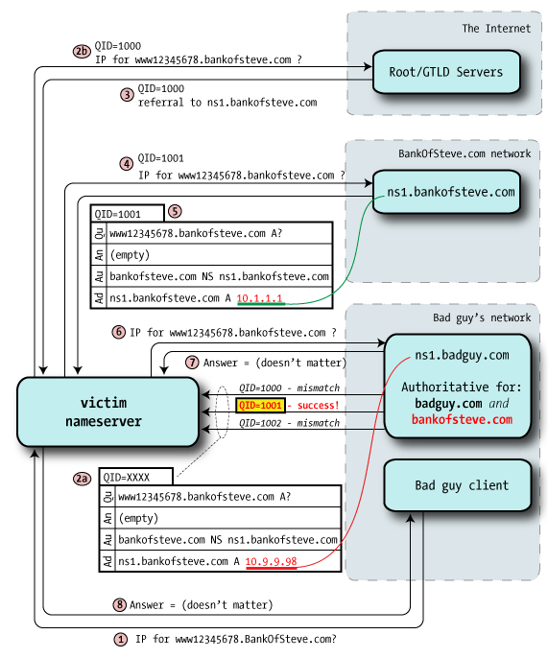
Dan’s Shenanigans
Notes:
Step 1 — bad guy client requests a random name within the target domain (www12345678.bankofsteve.com), something unlikely to be in cache even if other lookups for this domain have been done recently.
Step 2a — As before, the bad guy sends a stream of forged packets to the victim, but instead of A records as part of an Answer, it instead delegates to another nameserver via Authority records. "I don't know the answer, but you can ask over there".
The authority data may well contain the "real" bankofsteve.com nameserver hostnames, but the glue points those nameservers at badguy IPs. This is the crucial poisoning, because a Query ID match means that the victim believes that badguy's nameservers are authoritative for bankofsteve.com.
The bad guy now owns the entire zone.
Curiously, the rest of the steps don't matter: the point of this process was to fake out the victim into thinking that badguy runs the domain in question, and that would have been successful in this step.
Once one of the victim's queries has been poisoned — it could be any in the chain — all the rest are directed to badguy's servers.
This is a devastating attack: by owning the entire target domain, the bad guy controls essentially everything with respect to that resolving nameserver. He can redirect web visitors to his own servers (imagine redirecting google.com), he can route email to his own servers via serving up bogus MX records.

Slide 32
Port Scanning
https://medium.com/@avirj/nmap-tcp-syn-scan-50106f818bf1
Notes:
Open state
Closed state

Slide 33
Port Scanning
https://medium.com/@avirj/nmap-tcp-syn-scan-50106f818bf1
Notes:
Filtered
Open!

Slide 34
Outline
Computer Network Threat Model
Protocol Insecurities
DDoS
Wireless
Defenses: TLS, Firewalls, IDS, IPS

Slide 35
Denial of Service (DoS)
Intentional prevention of access to valued resource
CPU, memory, disk (system resources)
DNS, print queues, NIS (services)
Web server, database, media server (applications)
This is an attack on availability
Launching DoS attacks is easy
Preventing DoS attacks is very hard
Notes:
Not just network resource depletion
Oldies but goodies… again a fundamental issue with the design of the Internet

Slide 36
Example: SMURF Attack
Simple DoS attack:
Send a large number PING packets to a network’s broadcast IP addresses (e.g., 192.168.27.254)
Set the source packet IP address to be your victim
All hosts will reflexively respond to the ping at your victim
and it will be crushed under the load.
This is an amplification attack and a reflection attack
Notes:
Nice amplification attack, pings are cheap
Don’t allow pings from outside to inside your system!

Slide 37
DDoS 101 (do not replicate!)
Send a stream of legitimate requests
Send a few malformed packets
causing failures or expensive error handling
low-rate packet dropping (TCP congestion control)
“ping of death”
Abuse legitimate access
Compromise service/host
Use its legitimate access rights to consume the rights for domain (e.g., local network)
Notes:
General principles

Slide 38
DDoS
Notes:
Zombies are devices under control because of malware – sw that is doing something you did not intend to do with your device

Slide 39
IRC Botnets

Slide 40
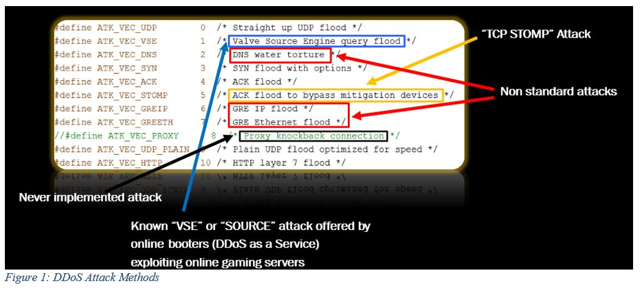
Mirai Botnet
Notes:
Oct. 2016
Open source code, lots of diffeerent types of DoS, some new

Slide 41
DDoS TCP SYN Flood
Attacker
Server
Spoofed Client
Insights:
Traffic pattern
Spoofed IPs
Send Spoofed SYN
Send SYN-ACK
Resend SYN-ACK
Notes:
I have done some research in SDN for mitigation. What is SDN?

Slide 42
DDoS Reality
None of the “protocol oriented” solutions have really seen any adoption
too many untrusting, ill-informed, mutually suspicious parties must play together
Real Solution
Large ISPs police their ingress/egress points very carefully
Watch for DDoS attacks and filter appropriately
Develop products that coordinate view from many vantage points in the network to identify upswings in traffic
Notes:
SDN, more secure devices that do not become part of a botnet in the first place

Slide 43
Outline
Computer Network Threat Model
Protocol Insecurities
DDoS
Wireless
Defenses: TLS, Firewalls, IDS, IPS

Slide 44
Wireless
Can it ever be secure?
Third party software
Open medium
Krack attack – WPA is not safe anymore

Slide 45
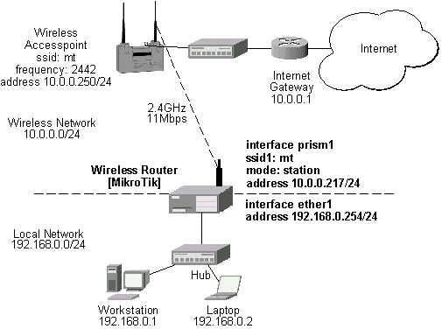
Wireless communication
802.11 Protocol Suite
2.4 GHz radio signal band
Use few channels: 1, 6, 11
Repeaters
Access Point
Notes:
Lab with airmon-ng
Access point or AP: receives, forwards, and transmits data
MAC & NIC
Access range! Distance is important
Poor signal, travel

Slide 46
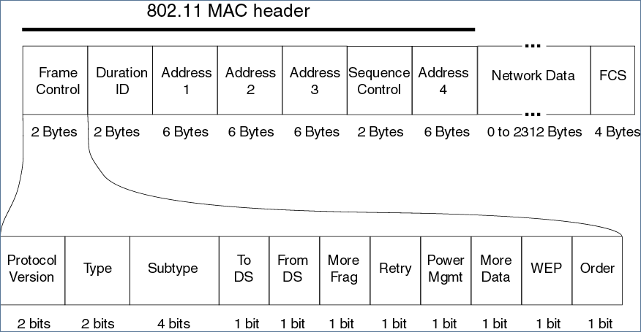
WiFi Frames
Wireshark Lab!
Notes:
Wireshark lab
Frame: MAC header payload 0-2304 bytes, FCS: Frame Check Sequence - CRC
MAC header: frame type (control)
ToDS/FromDS: direction to or from access point
Fragmentation, order control
WEP or encryption bit
Up to four MAC addresses
Management frame:
Beacon: signal that advertises that the network is accepting connections
Authentication: NIC requests connection by sending authentication frame, deauthenticaiton
Association Request/Response: NIC exchanges info about capabilities, interaction – session
SSID: string that identifies wireless AP Service Set Identifiers
Protocols defined in IEEE 802.11 standards
• Access points (APs) may periodically broadcast beacon frames to
advertise its presence (and some configuration parameters)
• Authentication:
• client sends authentication frame to AP
• if successful, client sends association request frame to AP,
requesting allocation of resources
• if successful, AP responds with association response frame
• Data sent via data frames
• Session Termination:
• AP sends disassociation frame and deauthentication frame

Slide 47
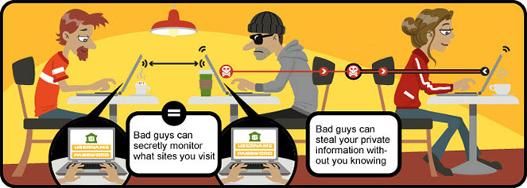
Wireless Vulnerabilities
CIA again
Public wifi… why is it unsafe?
Notes:
C: encryption or no encryption?
I: loss of signal, interference
A: bad equipment, partial loss, slowdown due to exceeding capacity
MiTM
Malware
Snooping – unencrypted data
Compromised devices
Compromised hotspot – pineapple
Everyone is the receiver
Anyone can join

Slide 48
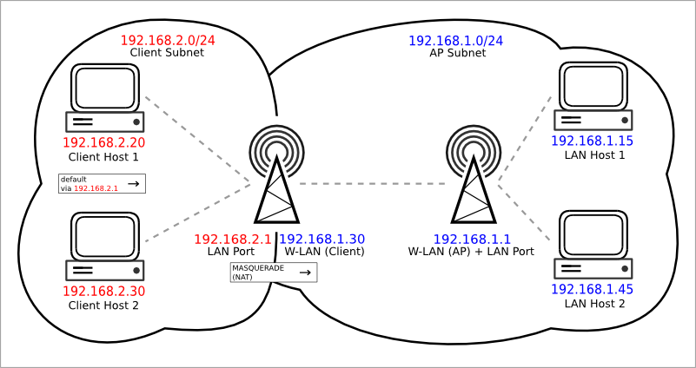
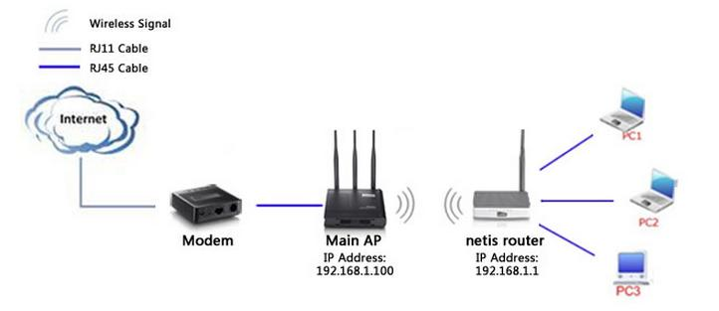
WiFi Vulnerabilities
Unauthorized Access
Protocol Vulnerabilities
Picking up the Beacon
SSID in all Frames
Authentication
Changeable MAC Addresses http://www.instructables.com/id/How-to-Spoof-Your-MAC-Address/
Stealing the Association
Preferred Associations
Notes:
Unauthorized Access
Anyone can pick and reply
Authentication is not rigorous (BYOD)
Any AP may accept any association with any device
Protocol Vulnerabilities
Lack of physical protection – prone to eavesdropping
Picking up the Beacon
Open mode: AP broadcasts, client responds
Closed mode: client is looking for SSID, broadcasts its message that includes the MAC address
What can possibly go wrong?
How would you fix it?
SSID in all Frames
Closed mode broadcast desired SSID
All frames reveal SSID
A better design: just use a shared data value for one associaton only. Initial authentication would reveal SSID, but a later frame would not
Authentication
Only accepted devices – authenticating based on mac address… is that a good idea?
Changeable MAC Addresses
OS does not consult hardware
One can change MAC address of NIC Card network card address table
MAC Spoofing
Stealing the Association
Promiscuous Aps accept any association
Free wifi – firesheep: picks unencrypted cookies from other people’s connections in a public wifi, authenticates as them
Preferred Associations
List of favorites… check your network settings
Does an SSID connect to a specific AP? Or is just the name enough? Does your phone/computer even ask for permission to connect to open wifi? (mine does…)

Slide 49
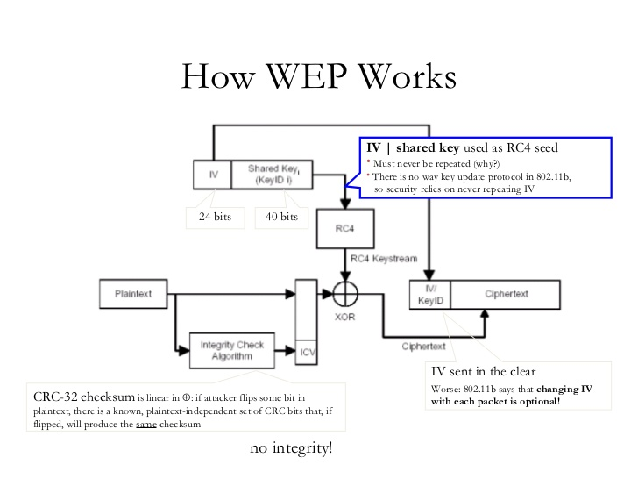
Notes:
WEP: Wired Equivalent Privacy
AP sends random number to client
Client encrypts it with shared key
Client returns ciphertext to AP
Client and AP authenticated
Problems:
Weak Encryption Key: 64 – 128 bits with 24 bit IV, vulnerable pass phrases
Static Key: shared between server & receiver, same key used for a long time, collect many data points, deduce key
Weak Encryption process: key can be brute forced, WEPCrack, AirCrack-ng crack in a few minutes
Weak Encryption Algorithm: IV submitted in plaintext, RC4 generates long sequence of RNs, WEP combines these with data using XOR, if attacker can guess decrypted value feeding it to XOR can guess key sequence
Initialization Vector Collisions: have to change after 16 million iterations, in practice may never change, not totally random changes, predictability degree
Faulty integrity check: CRC is well known, if attackers wants to change communication, simply change data, recalculate CRC
No authentication: attacker can fake SSID and MAC and there is no way to authenticate them

Slide 50
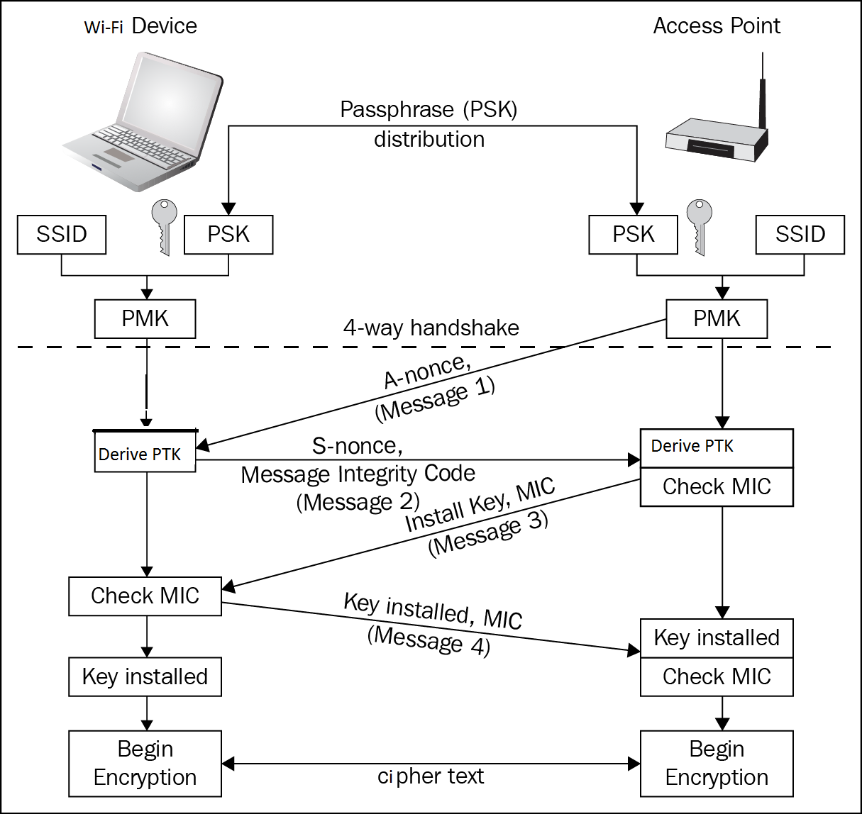
WPA
Notes:
1999 WEP was out
2001 flaws were published
2003 WPA – Wifi Protected Access
PMK: Pairwise Master Key
The AP sends a nonce-value to the STA (ANonce). The client now has all the attributes to construct the PTK - Pairwise Transient Key
The STA (station) sends its own nonce-value (SNonce) to the AP together with a Message Integrity Code (MIC), including authentication, which is really a Message Authentication and Integrity Code (MAIC).
The AP constructs and sends the GTK (Group Temporal Key) and a sequence number together with another MIC. This sequence number will be used in the next multicast or broadcast frame, so that the receiving STA can perform basic replay detection.
The STA sends a confirmation to the AP.
Strengths over WEP:
Non static encryption key – TKIP Temporal Key Integrity Program: encryption key is changed automatically on each packet. AP – authenticator, client- supplicant. Hierarchy of keys
Authentication: Extensible Authentication Protocol EAP – authentication by password, token, certificate, or other mechanism.
Strong encryption: WPA2 uses AES (why is it stronger than RC4?)
Integrity protection: 64-bit encrypted CRC
Session Initiation: 4- way handshake
Authentication stages:
• Shared secret used to derive encryption keys
• Client authenticates to AP
• Encryption keys are used to produce
keystreams for encrypting traffic
Two Modes:
• PSK (Pre-shared Key):
• also called “WPA Personal”
• shared secret manually entered into all devices
• designed for home use
• 802.1x Mode:
• also called “WPA Enterprise”
• authentication handled by backend service (e.g., RADIUS server)
via Extensible Authentication Protocol (EAP)
• may make use of certificates or other authentication techniques
• e.g., SaxaNet
Attacks:
MiTM
Incomplete Authentication
Exhaustive key search

Slide 51
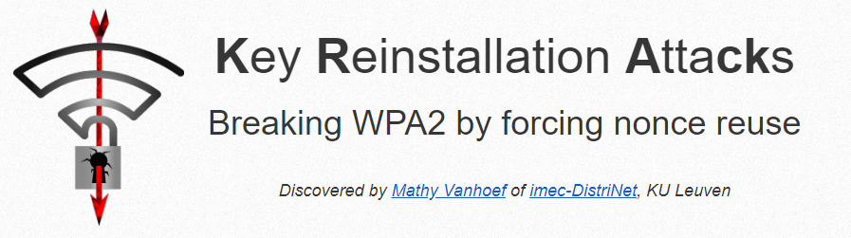
Krack Attack
WPA2 shown vulnerable to Key Reinstallation Attacks (KRACK) [https://www.krackattacks.com]
Tricks victim into using an already-in-use key by manipulating and replaying handshake messages
https://www.krackattacks.com/
Notes:
Impacts:
AES-CCMP: replay and decrypt, but not forge
AES-GCMP: replay, decrypt, forge
TKIP: replay, decrypt, forge

Slide 52
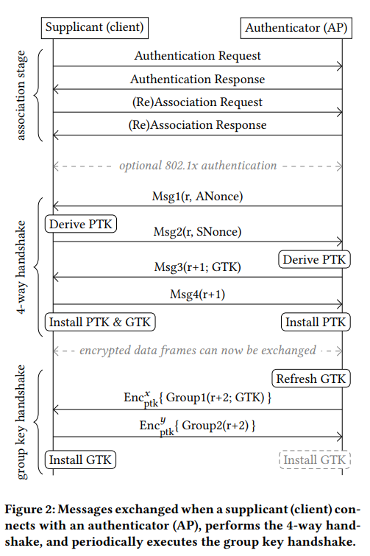
The Attack
Image from CCS’17 Publication “Key Reinstallation Attacks: Forcing Nonce Reuse in WPA2”
Mathy Vanhoef, Frank Piessens
https://youtu.be/Oh4WURZoR98
Notes:
When client joins the network, it executes a 4-way handshake to negotiate a fresh session key
• Installs key after receiving message 3 of handshake
• If AP does not receive appropriate response ACK, assumes messages are lost and retransmits message 3
• Therefore, as per the protocol, when client receives message 3, it reinstalls the same key and also resets the incremental transmit packet
number (IV) and replay counters
• The subsequent data is encrypted with the same key and IV … compromising confidentiality
“An attacker can force these nonce resets by collecting and replaying retransmissions of message 3 of the 4-way handshake” (quote)
Thus, the encryption protocol is attacked and an online criminal person can setup a fake WiFi access-point and interfere on a network. This means that the attacker gets access to private conversations and details about personal information and data of people connected via the public Wi-Fi network. Notably, our attack is exceptionally devastating against Android 6.0: it forces the client into using a predictable all-zero encryption key

Slide 53
Outline
Computer Network Threat Model
Protocol Insecurities
DDoS
Wireless
Defenses: TLS, Firewalls, IDS, IPS

Slide 54
Can we defend the network?
Crypto stuff in action: SSL/TLS
Firewalls
VPNs
IDS/IPS

Slide 55
SSL/TLS Message Types
Handshake
Alerts
Change cipher spec
Data

Slide 56
SSL/TLS with Server and Client Authentication
Notes:
Alice (client) initiates conversation with Bob (server)
Bob sends Alice his certificate
Alice verifies certificate
Alice picks a random number S and sends it to Bob, encrypted with Bob’s public key
Both parties derive key material from S
Client and server exchange encrypted and integrity- protected data
S: Symmetric Encryption, much faster
MAC: message authentication code
Drown attack cannot happen
Sign with private key, prove who you are

Slide 57
SSL/TLS and the Web
HTTPS: Tunnel HTTP over SSL/TLS
Add golden lock symbol

Slide 58
HTTP 1.0

Slide 59
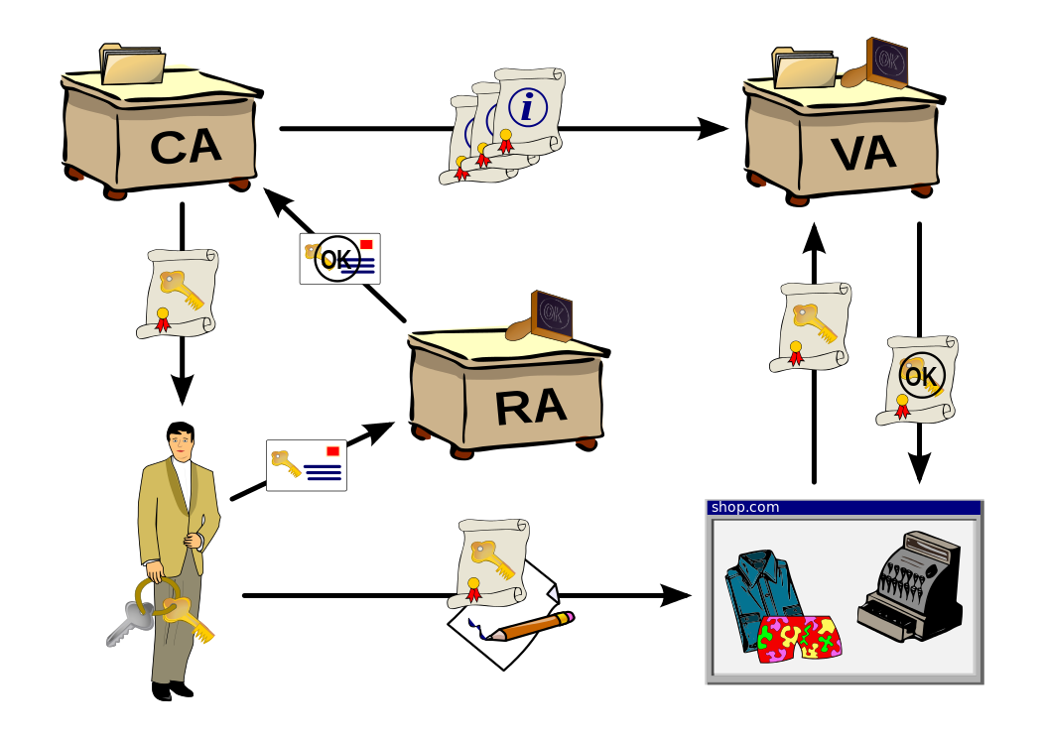
Problems with TLS/SSL
If Bob’s cert isn’t verified, how do you know you’re actually talking to Bob?
Solution: Use PKI
Trustico Fiasco: https://www.grc.com/sn/sn-653-notes.pdf
By Chris 論 - [1] and OpenCliparts.org, CC BY-SA 3.0, https://commons.wikimedia.org/w/index.php?curid=2501151
Notes:
Bind Bob’s public key with his identity
RA: Registration authority verifies the identity of entities requesting their digital certificates to be stored at the CA
VA: Validation Authority – third party, provides this entity information on behalf of the CA
A central directory—i.e., a secure location in which to store and index keys
A certificate management system managing things like the access to stored certificates or the delivery of the certificates to be issued.
A certificate policy stating the PKI's requirements concerning its procedures. Its purpose is to allow outsiders to analyze the PKI's trustworthiness.

Slide 60
Certificate Verification
SSL is an application layer protocol
Software developers must use it correctly
Pre-Smartphone World
Small set of applications that use SSL (E.g., Web Browser)
Lots of attention to those apps
Smartphone World
Hundreds of thousands of applications that use SSL
Many apps do not verify certificates correctly – Implications?
Developers change default configuration – WHY?

Slide 61
Filtering: Firewalls
Filtering traffic based on policy
Policy determines what is acceptable traffic
Access control over traffic
Accept or deny
May perform other duties
Logging (forensics, SLA)
Flagging (intrusion detection)
QoS (differentiated services) 2
Notes:
Firewall is a network device that isolates organization’s internal network from larger outside network/Internet. It can be a hardware, software, or combined system that prevents unauthorized access to or from internal network.
All data packets entering or leaving the internal network pass through the firewall, which examines each packet and blocks those that do not meet the specified security criteria.

Slide 62
IP Firewall Policy
Specifies what traffic is (not) allowed
Maps attributes to address and ports
Example: HTTP should be allowed to any external host, but inbound only to web-server
Rules typically refer to IP addresses, not hostnames -- WHY?
Notes:
Firewalls usually have a range of addresses, not just a single address
Packet filtering is generally accomplished by configuring Access Control Lists (ACL) on routers or switches. ACL is a table of packet filter rules.
Packet filter (stateful/stateless) vs application
Ips give info about internal vs external network, Ips are easier to parse in hw, domain names may be used as well, ports, words and phrases - DPI

Slide 63
Palo Alto filtering
Notes:
Application Identification
Threat
User Identification
✓ Gain visibility into who specifically is responsible for all application, content, and threat traffic on the network
✓ Enable the use of identity as a variable within access control policies
✓ Facilitate troubleshooting/incident response and reporting
Policy control
✓ Allow or deny ✓ Allow but scan for exploits, viruses, and other threats ✓ Allow based on schedule, users, or groups ✓ Decrypt and inspect ✓ Apply traffic shaping through QoS ✓ Apply policy‐based forwarding ✓ Allow certain application functions ✓ Allow (or prevent) certain types of file transfer ✓ Any combination of the aforementioned

Slide 64
DMZ (De-Militarized Zone)
Zone between LAN and Internet
Notes:
In computer security, a DMZ or demilitarized zone (sometimes referred to as a perimeter network) is a physical or logical subnetwork that contains and exposes an organization's external-facing services to an untrusted network, usually a larger network such as the Internet. The purpose of a DMZ is to add an additional layer of security to an organization's local area network (LAN); an external network node can access only what is exposed in the DMZ, while the rest of the organization's network is firewalled. The DMZ functions as a small, isolated network positioned between the Internet and the private network.
The firewall process can tightly control what is allowed to traverse from one side to the other. An organization that wishes to provide external access to its web server can restrict all traffic arriving at firewall expect for port 80 (the standard http port). All other traffic such as mail traffic, FTP, SNMP, etc., is not allowed across the firewall into the internal network. An example of a simple firewall is shown in the following diagram.
The name is derived from the term "demilitarized zone", an area between nation states in which military operation is not permitted.

Slide 65
Telecommuter VPNs: Client-to-Gateway
Notes:
Remote access VPN: Dr. X wants to connect to cofc network from home!
Mobile VPN
Enable access to grades, email, etc.
IPSec vs SSL

Slide 66
Gateway-to-Gateway VPNs
Notes:
Site to site VPN: data is encrypted from one gateway to another
Secure link between two sites.
Share resources such as docs and other types of data
Saves organizations from renting expensive dedicated leased lines
Saves money from email servers, file servers: they can be accessed from the remote site
US Site and UK site: maintain US site as the main site
Mobile users not based somewhere specific

Slide 67
How do we build VPNs?
We cannot rebuild the Internet
Notes:
VPN provides security and additional encapsulation
Packets in regular internet can be sniffed, not in VPN
Packets cannot be sniffed or modified: modifications would be detected from VPN gateway

Slide 68
VPN Tunneling
Notes:
But we can add an extra layer of cryptography with VPN and authentication

Slide 69
SSL VPN
Which layer?
Layered system:
the VPN transfers IP packets (of the virtual network) by serializing them on a SSL connection,
which itself uses TCP as a transport medium,
which is built over IP packets (on the physical unprotected network).
Notes:
Application layer - https
But what about the lower layers?
But then the client does not need software to configure VPN, just need a URL and access portal
Portal is GUI interface accessed via a browser
SSL VPN can imitate how IPSec works with a lightweight client
First time user: access VPN gateway via browser
Login, use active x or java, access VPN!
All settings done via browser, easy to setup
Will only allow systems that are compliant and up to date (access only if your antivirus is up to date)

Slide 70
IPsec VPN
IPsec is another technology which is more deeply integrated in the packets
IPsec VPN more efficient than SSL VPN
IPsec must be managed quite deep within the operating system network code
SSL-based VPN only needs some way to hijack incoming and outgoing traffic; the rest can be down in user-level software.
Notes:
IPSec is L3, quite low and close to OS
Can protect anything higher
Flexibility and strength in depth
Only drawback: setup corporate network on client and complex framework
Bot site to site and remote user

Slide 71
IPsec and the IP protocol stack
IPsec puts the two main protocols in between IP and the other protocols
AH: Authentication Header
ESP: Encapsulating Security Payload
Other functions provided by external protocols and architectures

Slide 72
Transport Mode
Notes:
AH authentication header
Ensures integrity with a hash function and a secret key hashed in the algorithm
Guarantees origin by authenticating IP packets
Sequence number prevents replay attacks
Use sliding window
Discard old packets
ESP Encapsulating Security Payload provides confidentiality data origin authentication, connectionless integrity, anti-replay service

Slide 73
Tunnel Mode
Notes:
Tunnel mode:
Tunnel mode protects the internal routing information by encrypting the IP header of the original packet.
The original packet is encapsulated by a another set of IP headers.
It is widely implemented in site-to-site VPN scenarios.
NAT traversal is supported with the tunnel mode.
Additional headers are added to the packet; so the payload MSS is less.
Transport mode: The transport mode encrypts only the payload and ESP trailer; so the IP header of the original packet is not encrypted.
The IPsec Transport mode is implemented for client-to-site VPN scenarios.
NAT traversal is not supported with the transport mode.
MSS is higher, when compared to Tunnel mode, as no additional headers are required.
The transport mode is usually used when another tunneling protocol (such as GRE, L2TP) is used to first encapsulate the IP data packet, then IPsec is used to protect the GRE/L2TP tunnel packets.

Slide 74
IDS/IPS
We have talked about:
Host IDS
Network IDS
How do we evaluate IDS?
True positives
True negatives
ROC
Difference between IDS/IPS

Slide 75
IDS Software
Snort
Bro
Suriccata

Slide 76
Summary
Network security and the attackers asymmetric advantage
Protocol insecurities
DDoS
Wireless galore
Defenses

